Slide 1

Building Web Applications in R with Shiny-The Basics
library(dplyr)
rladies_global %>%
filter(city == 'Louisville')

Slide 2
What is R Shiny?
Shiny is an R package that makes it easy to build interactive web apps straight from R. You can host standalone apps on a webpage or embed them in R Markdown documents or build dashboards. You can also extend your Shiny apps with CSS themes, htmlwidgets, and JavaScript actions.
NO WEB DEVELOPMENT SKILLS NECESSARY!

Slide 3
What can Shiny do?
Geographical, Scientific, Marketing, Health, Pop Culture Data Visualization (basically any dataset you could imagine)
Great for ”Big Data” and sharing with non-programmers
Range in complexity from simple to very advanced
Highly customizable
R-Ladies Shiny App
Shiny Gallery

Slide 4
The Basics

Slide 5
Two main components
1.) UI (User Interface)
Web document but can be generated from R
generates html code
Instructions for how the app will look and be laid out
2.) Server
The actual behind-the-scenes R programming that creates the data visualization (plots)
Open Console and Run UI Code Only

Slide 6
UI
Inputs—collects values from the user, the variable(s) your user can toggle
Outputs– the R objects your user sees ex. graphs, maps, tables, text and they respond when the user changes the input

Slide 7
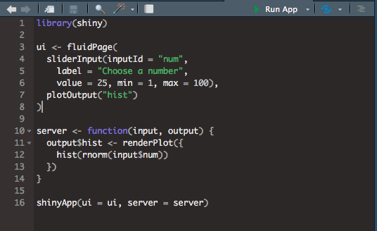
Simple Example UI Code

Slide 8
Server
In the server code,
save objects to display to output$____ where ____ is the name of the output in the UI code
call input variables with input$____ where ____ is the name of the input variable in the UI code
Uses render functions { } to indicate code blocks

Slide 9
Simple Example Server Code

Slide 10
Third Component
3.) ShinyApp
Knits the UI and Server together
Go to R Console to Run the Example Code!

Slide 11
Putting it All Together

Slide 12
Sharing your Shiny App
Make sure all of the files your app uses are located in a single directory
Must name app code “app.R”
Sign up for an account at shinyapps.io
install shinyapps
a “publish” button will now appear in your R Studio console

Slide 13
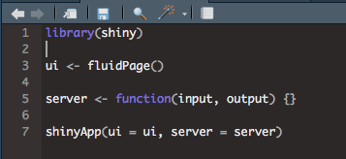
Shiny App Template

Slide 14
The hardest part is planning how you want to present your data and what you will make interactive."
—Sam Carlisle
(August 2018)

Slide 15
Creating a Shiny App
is EASY
First
Second
Last
Plan what your app will look like and what users will interact with
Use Shiny template to design UI and server
Publish your app

Slide 16
My First R Shiny App
Metabolomics Boxplots

Slide 17
R Shiny Resources
Video Tutorial Series with Garrett Grolemund
https://shiny.rstudio.com/tutorial/
R Studio Shiny “Cheat Sheet”
https://shiny.rstudio.com/images/shiny-cheatsheet.pdf
Many others!

Slide 18



More info #RLadiesGlobal
Github (resources,
presentations, ...)
Website
Twitter
Slack
github.com/rladies/
rladies.org
@RLadiesGlobal
rladies-community-slack.herokuapp.com

Slide 19


More info #RLadiesLouisville
Github (resources,
presentations, ...)
Twitter
Meetup
E-mail
github.com/rladies/meetup-presentation_louisville!
@RLadiesLouville
meetup.com/rladies-louisville/
louisville@rladies.org
Be a speaker!
Host an event!
Watch for upcoming meetups (meetup/twitter)!
get involved!

Slide 20


Thank you!
Global

